Slide 1
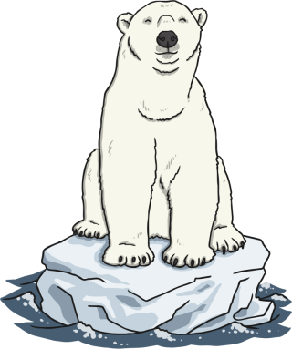
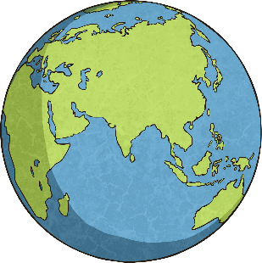

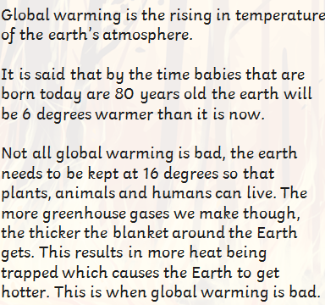
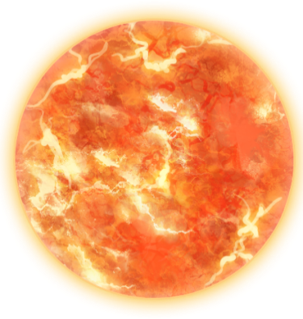

Slide 2
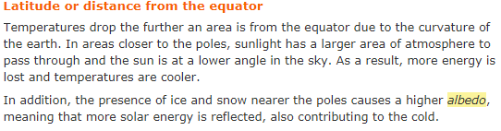
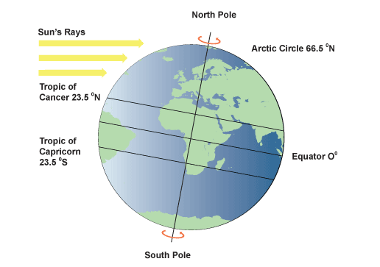
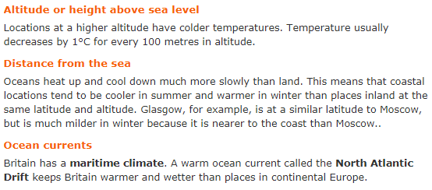
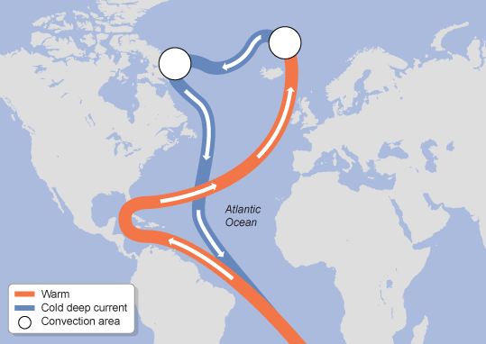
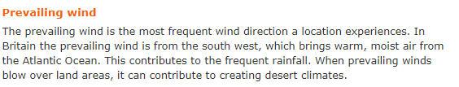
Global Climate Change
the spatial distribution of the world’s rainfall and temperature patterns

Slide 3
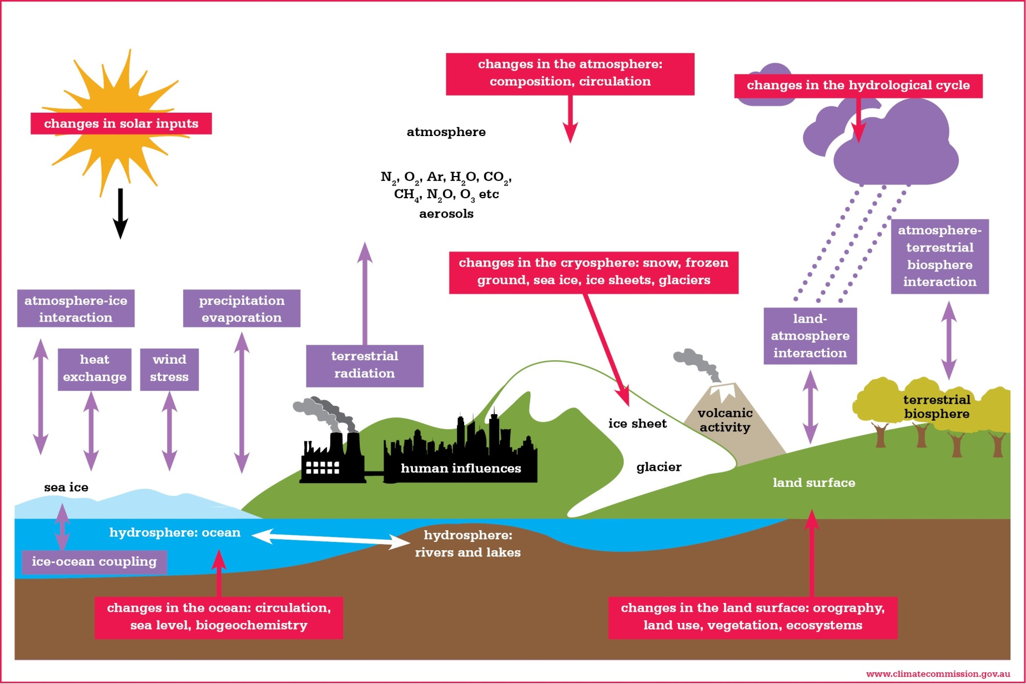
The Climate System

Slide 4
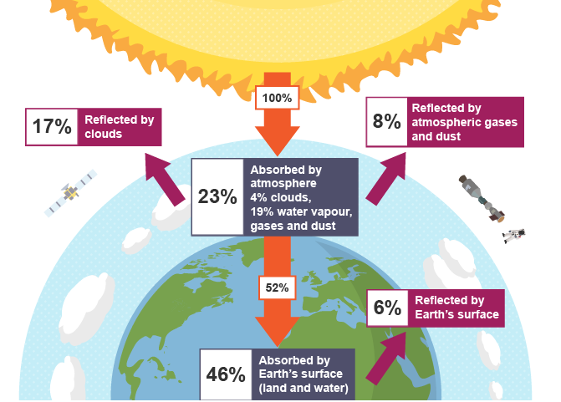
The Heat Budget
the key elements of the following natural systems: heat budget (including the greenhouse effect),hydrological cycle, carbon cycle and atmospheric circulation, and the ways in which they interact to influence the Earth’s climate
Heat

Slide 5
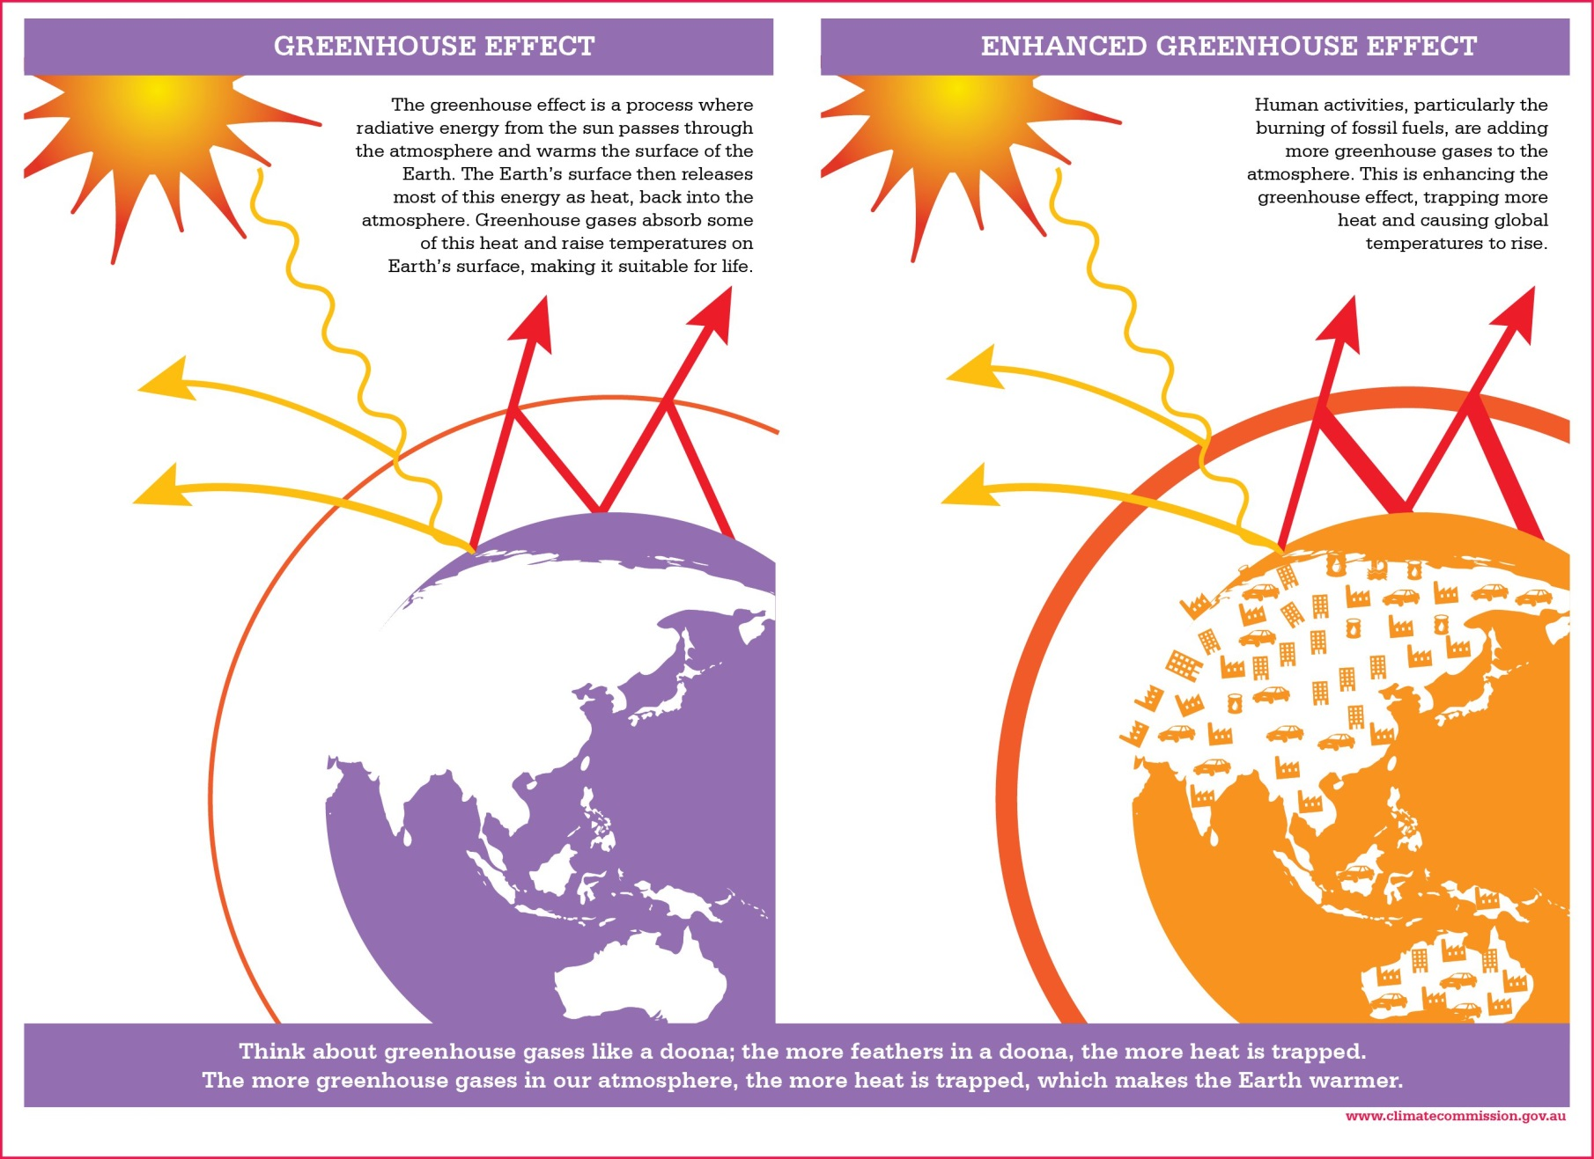
The Greenhouse Effect

Slide 6
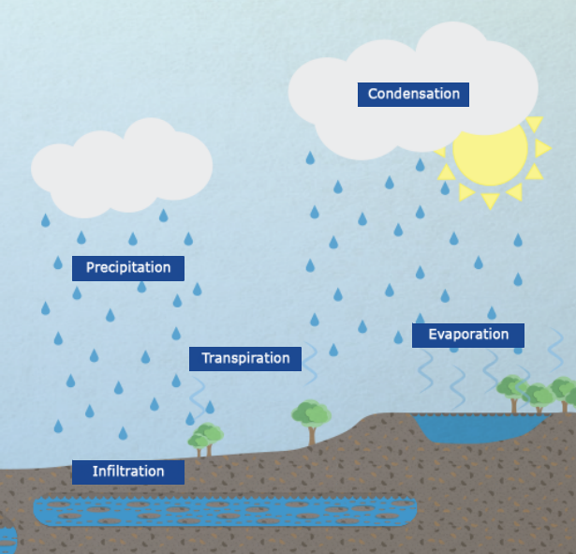
The Hydrological Cycle

Slide 7
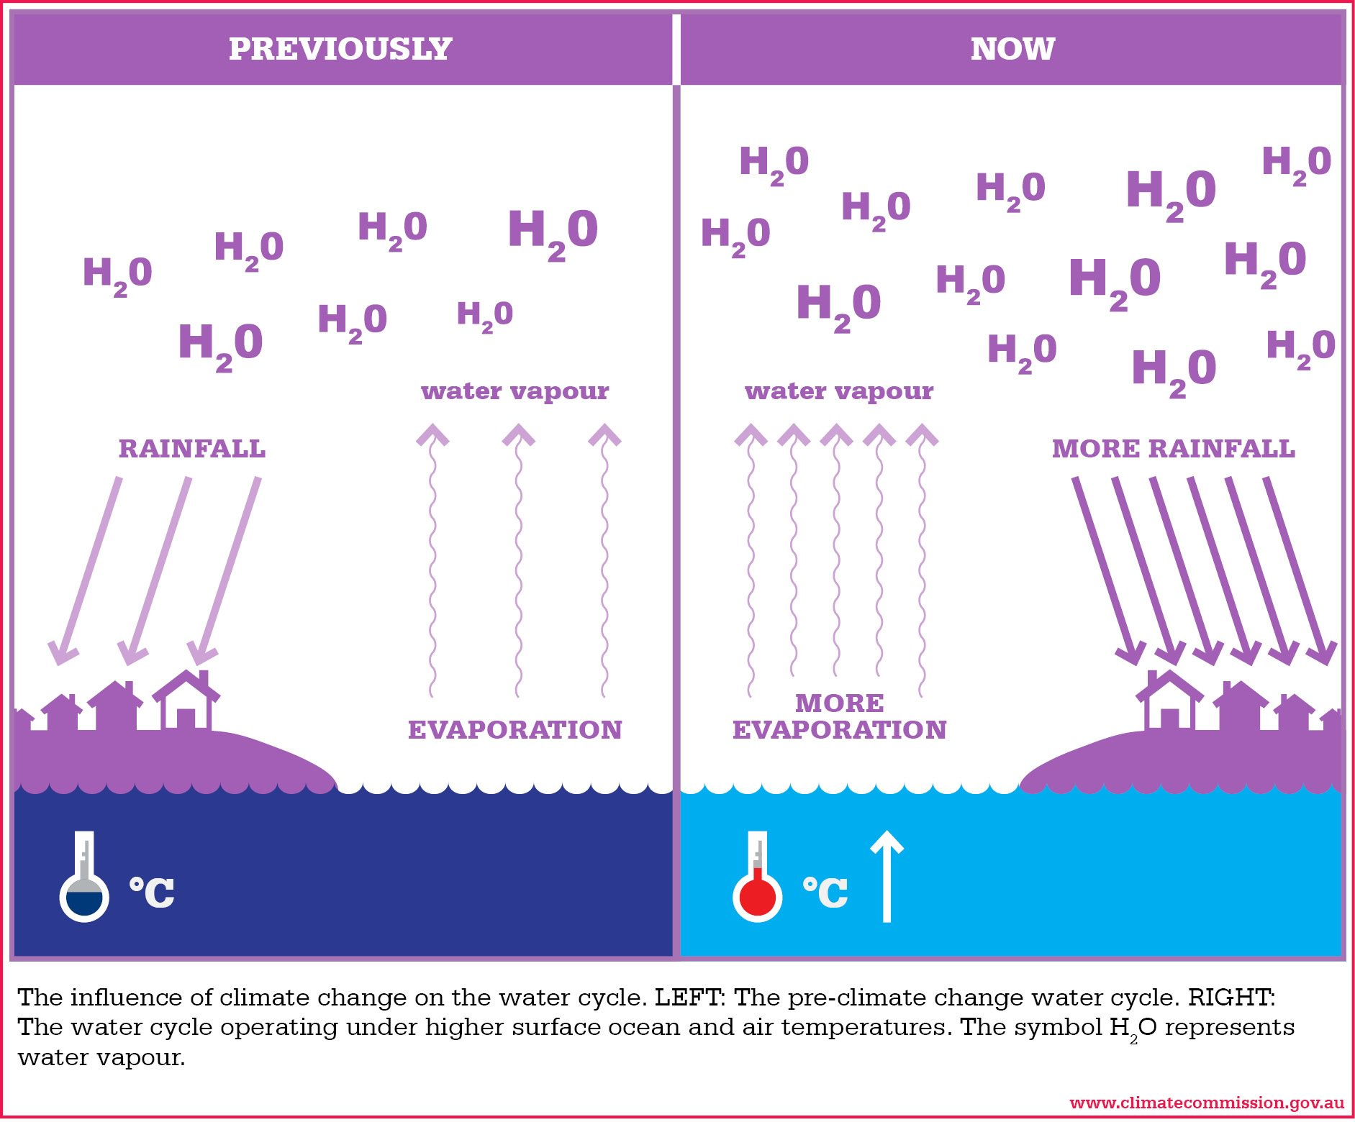
The Hydrological Cycle

Slide 8
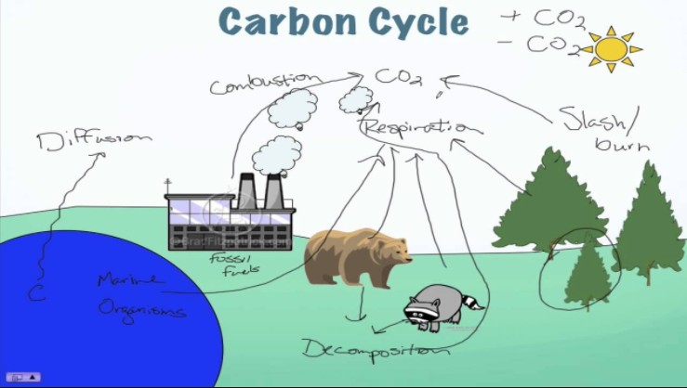
The Carbon Cycle

Slide 9
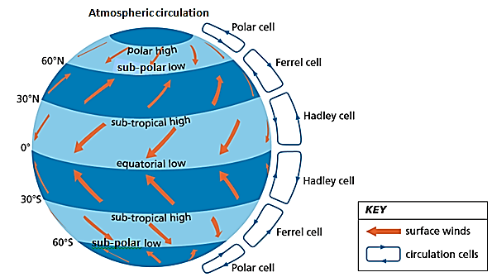
Atmospheric Circulation

Slide 10
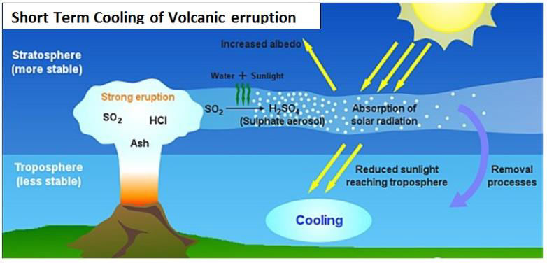
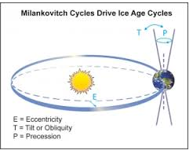
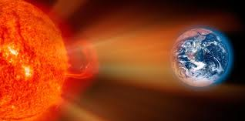
Natural Climate Change
the causes (natural and anthropogenic) and rate of global climate change

Slide 11
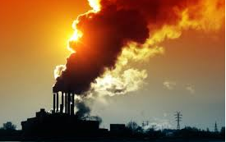
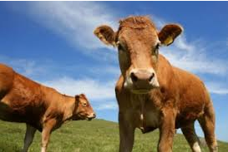
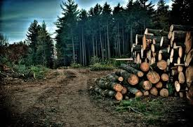
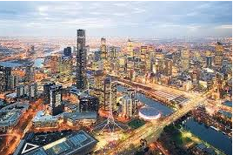
Anthropogenic Climate Change

Slide 12
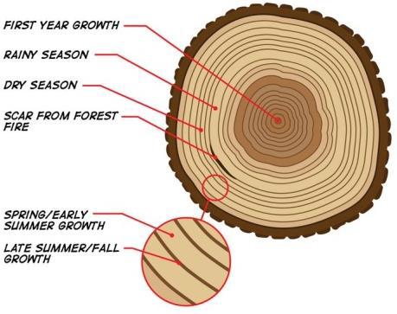

Proxy Data
one major type of evidence for climate change through geological time
Proxy Data: refers to data from the past that is collected using: tree rings, coral growth, fossils, Ice cores, and mud sediment

Slide 13
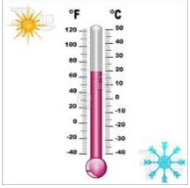
Direct Measurement
one major type of evidence for climate change in recent human history
Instrument Data: refers to direct data which is collected using instruments that measure real data. Huge amounts of data are recorded worldwide everyday by meteorological instruments.

Slide 14
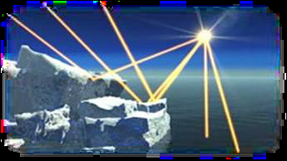
Albedo
the interrelationship between land cover change and climate, including changes to surface reflectivity (albedo) and the process of natural carbon sequestration
Refers to the amount of solar radiation reflected by an object. Specifically, it is the ratio of reflected to incident solar radiation.
Albedo is a unit-less measure of reflectivity that varies from 0 (no reflectance) to 1 (complete reflectance), although it is also commonly shown as a percentage (0% to 100%).

Slide 15
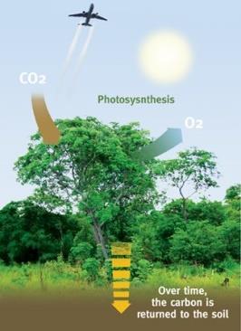
Natural Carbon Sequestration
Natural sources of carbon dioxide are balanced by natural carbon sinks.
Carbon can be sequestered from the atmosphere by plants. Plants have the capacity to act as a storage sink of Carbon
Terrestrial sequestration utilizes natural processes in ecosystems to absorb CO2 from the atmosphere and store it in plants, animals, and soil.
A carbon sink is a natural environment (e.g. a forest) viewed in terms of its ability to absorb carbon dioxide from the atmosphere. Carbon sinks because they help prevent, or at least limit, global climate by enhancing carbon storage (in trees and soils), preserving existing tree and soil carbon, and reducing
greenhouse gas emissions.

Slide 16
Effects of Climate Change in Natural Biomes
the effects of climate change on land cover in natural and anthropogenic biomes (vegetation, ice sheets, glaciers, coastal systems and coral reefs, agriculture, urban settlements and industry)
VEGETATION:
1. Shifting Ecological Boundaries: The shift in rainfall patterns and increased temperatures will impact on natural biomes. The extent and distribution of these ecosystems will change over time as climate conditions prevail e.g. coniferous forests will move further north and invade areas of tundra. Some species will become extinct as they may not be able to cope with shifting climate regions.
ICE SHEETS:
1. The cryosphere is all those areas of the Earth where the surface is frozen including the polar ice caps, continental ice sheets, glaciers, sea ice, and permafrost. Climate change has a strong effect on the cryosphere.
GLACIERS:
Warmer global temperatures further reduce glacial ice. Glacial National Park, Montana USA, was created in 1910. At this time there were 150 glaciers. Since then the number has decreased to 30. It is predicted that within 30 years most if not all the park’s glaciers will disappear.
CORAL REEFS:
1. Coral reefs are extremely sensitive to climate changes.
2. Sea temperature increases and coral stress from other impacts may increase corals' vulnerability to bleaching. Bleached corals often die if the stress persists. Coral reefs that have high rates of coral death following bleaching can take many years or decades to recover.
COASTAL SYSTEMS:
- Rising sea levels will bring significant changes to the coastal zones. Already sea level increases have been observed in both Australia and globally by approximately 2mm per year since the turn of the 20th century
- Two main factors that have caused this rise include:
- i) melting ice (i.e. ice sheets and glaciers)
- ii) thermal expansion caused by global warming. Warmer water expands and the oceans therefore take up a greater volume.

Slide 17
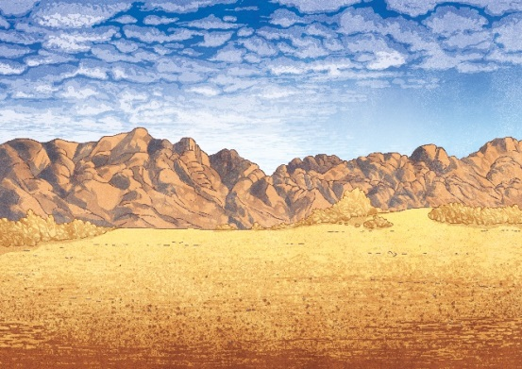
Effects of Climate Change in Anthropogenic Biomes
AGRICULTURE:
1. Agriculture is particularly vulnerable to major climatic variations.
2. Changing agricultural boundaries: Climate change can bring about changes to the type of agricultural activity undertaken in different regions. A 1-30C increase in temperature is likely to benefit crops in mid to high latitudes but will have negative effects on major crop production in low latitudes. Higher temperatures will put further heat stress on livestock and increased evaporation will lead to desertification in large areas.
3. Lower rainfall and higher temperatures are expected to reduce crop yields in the South West Wheat belt by more than 30 percent by 2050. Marginal lands of the Wheat Belt will become unproductive.
URBAN SETTLEMENTS AND INDUSTRY
Dense population in urban settlements are particularly vulnerable to the impacts of climate change as they are immobile. Climate change is especially impacting on poor people.
Impacts of Climate change on Urban Settlement and Industry:
Rising temperatures
Changing rainfall patterns
Ocean water levels
Natural hazards

Slide 18
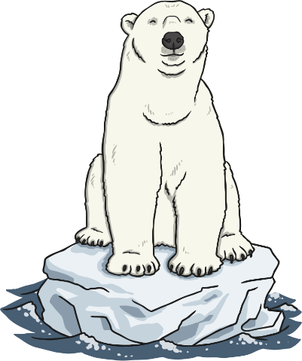
Impacts of Global Climate Change
1. By 2100 all areas of the world are predicted to have increased in average global temperatures by between 10C to 60C. High latitudes of the northern hemisphere are expected to increase the most and this will result in further melting of polar ice resulting in sea level rise. It is forecast that there will be significant changes in rainfall patterns with some areas becoming wetter and other areas becoming drier. There will be an increase in extreme weather events.
2. As sea levels rise, some island groups could be completely covered by rising sea levels (e.g. Kiribati, Tuvalu, Maldives) resulting in the climate change refugees
3. The coastal location of many major cities (e.g. Shanghai, New York, London, Los Angeles, and Mumbai) will also become seriously vulnerable to rising sea levels and may result in the displacement of millions of people.
4. Warmer temperatures will contribute to an increase in extreme weather events such as cyclones and floods.
5. Suitable habitat for a range of iconic species, including the quokka, Carnaby’s Black Cockatoo and the tingle tree, is likely to be substantially reduced as the climate changes

Slide 19
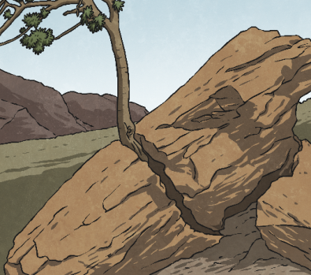
Practise Questions
1. A) Identify one natural and one anthropogenic cause of global climate change or biodiversity loss. (2 marks)
B) Describe the rate of global climate change or biodiversity loss, with reference to a specific example. (2 marks)
2. Explain the interrelationship between land cover change and climate or biodiversity. (4 marks)
3. Describe the spatial distribution of the world’s rainfall and temperature patterns or natural biomes. (8 marks)
4. For global climate change or loss of biodiversity, discuss one major type of evidence through geological time and one major type of evidence in recent human history. (12 marks)

Slide 20
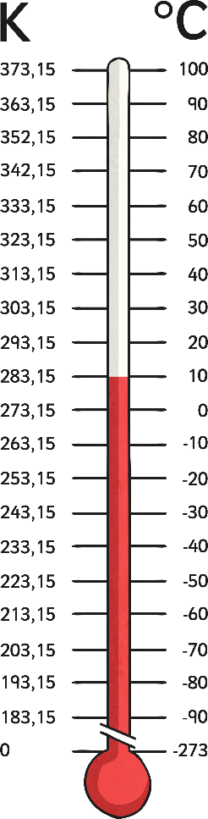
Practise Questions
5. Describe four key elements of one of the following:
- hydrological cycle - atmospheric circulation - heat budget
- ecosystem structure - ecosystem dynamics - carbon cycle (8 marks)
6. Discuss the effects of climate change or biodiversity loss in one
natural and one anthropogenic biome. (12 marks)
7. Describe one current and one proposed strategy implemented to
mitigate the adverse effects of global climate change or loss of
biodiversity. (8 marks)
8 Evaluate two ways that human activity has adapted to global
climate change or loss of biodiversity. (12 marks)

Slide 21
